Slide 1
Data Analysis
With Python

Slide 2
six steps for Data Analysis
Ask or Specify Data Requirements
Prepare or Collect Data
Clean and Process
Analyze
Share
Act or Report

Slide 3
Prerequisites for Data Analysis
Python For Data Analysis
SQL For Data Analysis
Python Data Visulization
Data Analysis Datasets
Notes:
https://www.geeksforgeeks.org/data-analysis-tutorial/?ref=shm

Slide 4
Data Analysis Libraries
Pandas
Numpy
Matplotlib

Slide 5
Data Analysis Tools
Excel
Tableau
Power BI

Slide 6
Python For Data Analysis
Notes:
https://www.geeksforgeeks.org/data-analysis-with-python/?ref=outind

Slide 7
Pandas
The name of Pandas is gotten from the word Board Information, and that implies an Econometrics from Multi-faceted information. It was created in 2008 by Wes McKinney and is used for data analysis in Python.
Processing, such as restructuring, cleaning, merging, etc., is necessary for data analysis. Numpy, Scipy, Cython, and Panda are just a few of the fast data processing tools available.

Slide 8
Data Structures
Series
Data Frame
import pandas as pd
import numpy as np
info = np.array(['P','a','n','d','a','s'])
a = pd.Series(info)
print(a)
import pandas as pd
x = ['Python', 'Pandas']
df = pd.DataFrame(x)
print(df)
Notes:
https://www.tpointtech.com/python-pandas-series

Slide 9
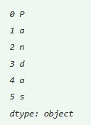
Pandas Series
<series object> = pandas.Series()
#Example
import pandas as pd
import numpy as np
info = np.array(['P','a','n','d','a','s'])
a = pd.Series(info)
print(a)

Slide 10
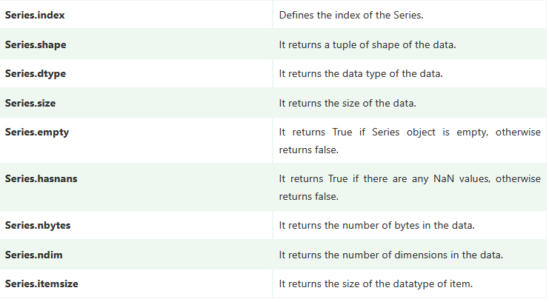
Pandas Series Attribute

Slide 11
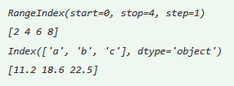
Retrieving Index array and data array
import numpy as np
import pandas as pd
x=pd.Series(data=[2,4,6,8])
y=pd.Series(data=[11.2,18.6,22.5], index=['a','b','c'])
print(x.index)
print(x.values)
print(y.index)
print(y.values)

Slide 12

Types (dtype) and Size of Type
import numpy as np
import pandas as pd
a=pd.Series(data=[1,2,3,4])
b=pd.Series(data=[4.9,8.2,5.6],
index=['x','y','z'])
print(a.dtype)
print(a.itemsize)
print(b.dtype)
print(b.itemsize)

Slide 13

Retrieving Dimension, Size and Number
import numpy as np
import pandas as pd
a=pd.Series(data=[1,2,3,4])
b=pd.Series(data=[4.9,8.2,5.6],
index=['x','y','z'])
print(a.ndim, b.ndim)
print(a.size, b.size)
print(a.nbytes, b.nbytes)

Slide 14
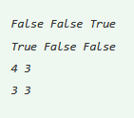
Checking Emptiness and NaNs
import numpy as np
import pandas as pd
a=pd.Series(data=[1,2,3,np.NaN])
b=pd.Series(data=[4.9,8.2,5.6],index=['x','y','z'])
c=pd.Series()
print(a.empty,b.empty,c.empty)
print(a.hasnans,b.hasnans,c.hasnans)
print(len(a),len(b))
print(a.count( ),b.count( ))

Slide 15
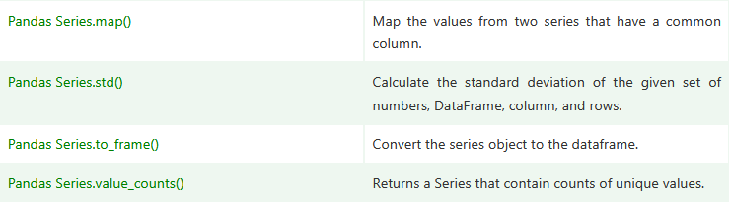
Functions
Notes:
https://www.tpointtech.com/python-pandas-series

Slide 16
Create an empty DataFrame
import pandas as pd
df = pd.DataFrame()
print (df)
Notes:
https://www.tpointtech.com/python-pandas-series

Slide 17
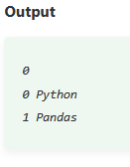
DataFrame using List
# importing the pandas library
import pandas as pd
# a list of strings
x = ['Python', 'Pandas']
# Calling DataFrame constructor on list
df = pd.DataFrame(x)
print(df)
Notes:
https://www.tpointtech.com/python-pandas-series

Slide 18
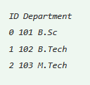
DataFrame from Dict of ndarrays
import pandas as pd
info = {'ID' :[101, 102, 103],'Department' :['B.Sc','B.Tech','M.Tech',]}
df = pd.DataFrame(info)
print (df)
Notes:
https://www.tpointtech.com/python-pandas-series

Slide 19

DataFrame from Dict of Series
import pandas as pd
info = {'one' : pd.Series([1, 2, 3, 4, 5, 6], index=['a', 'b', 'c', 'd', 'e', 'f']),
'two' : pd.Series([1, 2, 3, 4, 5, 6, 7, 8], index=['a', 'b', 'c', 'd', 'e', 'f', 'g', 'h'])}
d1 = pd.DataFrame(info)
print (d1)
Notes:
https://www.tpointtech.com/python-pandas-dataframe

Slide 20
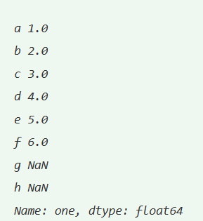
Column Selection
# importing the pandas library
import pandas as pd
info = {'one' : pd.Series([1, 2, 3, 4, 5, 6], index=['a', 'b', 'c', 'd', 'e', 'f']),
'two' : pd.Series([1, 2, 3, 4, 5, 6, 7, 8], index=['a', 'b', 'c', 'd', 'e', 'f', 'g', 'h'])}
d1 = pd.DataFrame(info)
print (d1 ['one'])
Notes:
https://www.tpointtech.com/python-pandas-dataframe

Slide 21
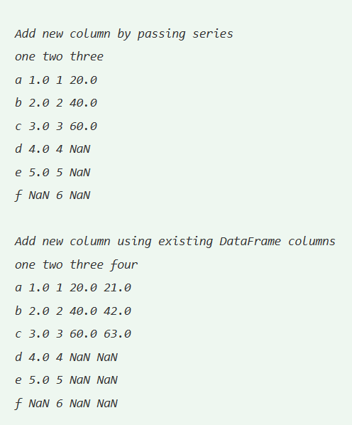
Column Addition
import pandas as pd
info = {'one' : pd.Series([1, 2, 3, 4, 5], index=['a', 'b', 'c', 'd', 'e']),
'two' : pd.Series([1, 2, 3, 4, 5, 6], index=['a', 'b', 'c', 'd', 'e', 'f'])}
df = pd.DataFrame(info)
# Add a new column to an existing DataFrame object
print ("Add new column by passing series")
df['three']=pd.Series([20,40,60],index=['a','b','c'])
print (df)
print ("Add new column using existing DataFrame columns")
df['four']=df['one']+df['three']
print (df)
Notes:
https://www.tpointtech.com/python-pandas-dataframe

Slide 22
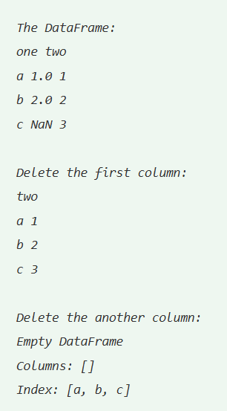
Column Deletion
import pandas as pd
info = {'one' : pd.Series([1, 2], index= ['a', 'b']),
'two' : pd.Series([1, 2, 3], index=['a', 'b', 'c'])}
df = pd.DataFrame(info)
print ("The DataFrame:")
print (df)
# using del function
print ("Delete the first column:")
del df['one']
print (df)
# using pop function
print ("Delete the another column:")
df.pop('two')
print (df)
Notes:
https://www.tpointtech.com/python-pandas-dataframe

Slide 23
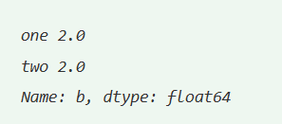
Row Selection:Label
# importing the pandas library
import pandas as pd
info = {'one' : pd.Series([1, 2, 3, 4, 5], index=['a', 'b', 'c', 'd', 'e']),
'two' : pd.Series([1, 2, 3, 4, 5, 6], index=['a', 'b', 'c', 'd', 'e', 'f'])}
df = pd.DataFrame(info)
print (df.loc['b'])
Notes:
https://www.tpointtech.com/python-pandas-dataframe

Slide 24
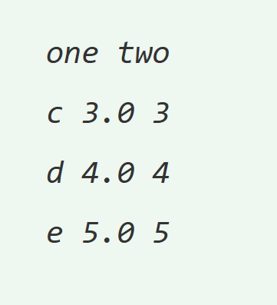
Row Selection: multiple row
import pandas as pd
info = {'one' : pd.Series([1, 2, 3, 4, 5], index=['a', 'b', 'c', 'd', 'e']),
'two' : pd.Series([1, 2, 3, 4, 5, 6], index=['a', 'b', 'c', 'd', 'e', 'f'])}
df = pd.DataFrame(info)
print (df[2:5])
Notes:
https://www.tpointtech.com/python-pandas-dataframe

Slide 25
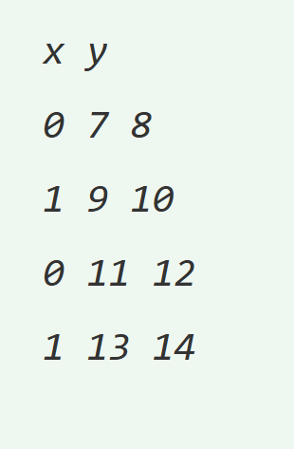
Row Selection: addition row
import pandas as pd
d = pd.DataFrame([[7, 8], [9, 10]], columns = ['x','y'])
d2 = pd.DataFrame([[11, 12], [13, 14]], columns = ['x','y'])
d = d.append(d2)
print (d)
Notes:
https://www.tpointtech.com/python-pandas-dataframe

Slide 26
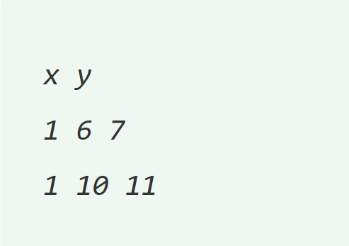
Row Delete
import pandas as pd
a_info = pd.DataFrame([[4, 5], [6, 7]], columns = ['x','y'])
b_info = pd.DataFrame([[8, 9], [10, 11]], columns = ['x','y'])
a_info = a_info.append(b_info)
# Drop rows with label 0
a_info = a_info.drop(0)
Notes:
https://www.tpointtech.com/python-pandas-dataframe

Slide 27
Pandas DataFrame
DataFrame.append() | Add the rows of other dataframe to the end of the given dataframe.
DataFrame.apply() | Allows the user to pass a function and apply it to every single value of the Pandas series.
DataFrame.assign() | Add new column into a dataframe.
DataFrame.astype() | Cast the Pandas object to a specified dtype.astype() function.
DataFrame.concat() | Perform concatenation operation along an axis in the DataFrame.
DataFrame.count() | Count the number of non-NA cells for each column or row.
DataFrame.describe() | Calculate some statistical data like percentile, mean and std of the numerical values of the Series or DataFrame.
DataFrame.drop_duplicates() | Remove duplicate values from the DataFrame.
DataFrame.groupby() | Split the data into various groups.

Slide 28
Pandas DataFrame Function
DataFrame.head() | Returns the first n rows for the object based on position.
DataFrame.hist() | Divide the values within a numerical variable into "bins".
DataFrame.iterrows() | Iterate over the rows as (index, series) pairs.
DataFrame.mean() | Return the mean of the values for the requested axis.
DataFrame.melt() | Unpivots the DataFrame from a wide format to a long format.
DataFrame.merge() | Merge the two datasets together into one.
DataFrame.pivot_table() | Aggregate data with calculations such as Sum, Count, Average, Max, and Min.
DataFrame.query() | Filter the dataframe.
DataFrame.sample() | Select the rows and columns from the dataframe randomly.
DataFrame.shift() | Shift column or subtract the column value with the previous row value from the dataframe.

Slide 29
Pandas DataFrame Function
DataFrame.sort() | Sort the dataframe.
DataFrame.sum() | Return the sum of the values for the requested axis by the user.
DataFrame.to_excel() | Export the dataframe to the excel file.
DataFrame.transpose() | Transpose the index and columns of the dataframe.
DataFrame.where() | Check the dataframe for one or more conditions.

Slide 30
SQL For Data Analysis

Slide 31
Python Data Visulization

Slide 32
Data Analysis Datasets

